Slide 1
HTTP Communication
Caching HTTP Requests with Interceptors
Lecture 4
By James(Jin) Wang
12/25/2021

Slide 2
Outline
Consuming REST services
Retrieving data with resolvers
Creating interceptors
Caching data in your apps
Unit testing

Slide 3
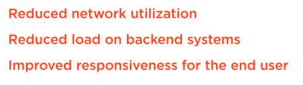
Caching HTTP Requests with Interceptors
  Benefits of Caching

Slide 4
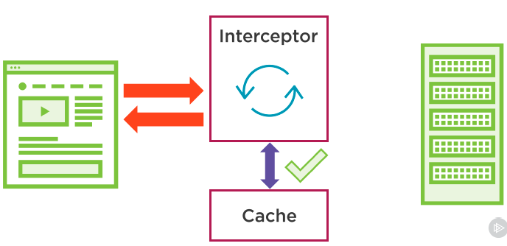
Caching HTTP Requests with Interceptors
  Caching with Interceptors

Slide 5
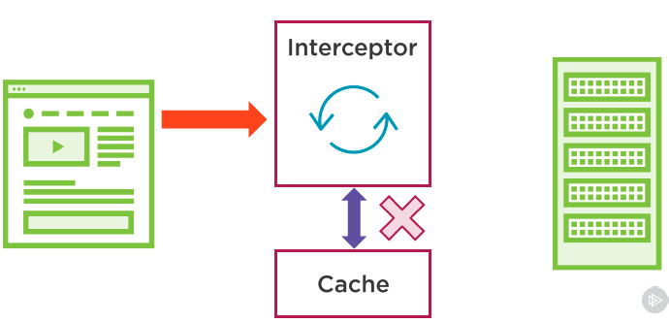
Caching HTTP Requests with Interceptors
  Caching with Interceptors

Slide 6
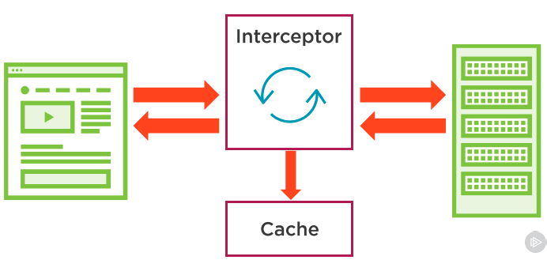
Caching HTTP Requests with Interceptors
  Caching with Interceptors

Slide 7
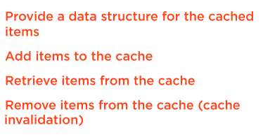
Caching HTTP Requests with Interceptors
  Role of the Cache Service

Slide 8
Caching HTTP Requests with Interceptors
  Create a service to store cached HTTP requests
  Demo: create service to store cached HTTP request

Slide 9
Summary

Slide 10
Assignment

Slide 11
Self Study
  Angular HTTP Communication
  https://app.pluralsight.com/library/courses/angular-http-communication

